Slide 1
Modeling of Thermal Damage from Focused Ultrasound Exposures for Heterogeneous Tissues
Adam C. Waspe, PhD adam.waspe@sickkids.ca
Aug. 11, 2014
* Some content adapted from lecture notes from Rajiv Chopra and Charles Mougenot and cited references

Slide 2
What is Focused Ultrasound?
Focused ultrasound is a noninvasive technique to enhance biological therapies by exposing tissues to acoustic energy:
Spatial / temporal control over temperature
Localized drug delivery (thermal, mechanical)
Functional / structural modification of tissues
Clinical adoption of FUS has expanded rapidly in recent years due to an active research community, strong commercial support, and better visualization/thermometry tools
Paediatric/foetal applications are starting to be explored, due to the potential to delivery a non-ionizing energy based therapy, in a noninvasive manner
Notes:
Acoustic radiation is usually at a much higher power level than those produced during diagnostic ultrasound
Temperature is focally controlled with high precision, targeting millimeter scale structures without damaging peripheral tissues
Hyperthermia – non-ablative temperature elevation to modulate perfusion/drug delivery
Thermal drug delivery – heat activated drugs (Thermodox)
Mechanical drug delivery – vascular permeability (BBB disruption), cell membrane permeability (sonoporation), drug-encapsulated microbubbles
Functional modification – sonothrombolysis
Structural modification – cavitation

Slide 3
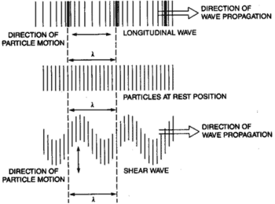
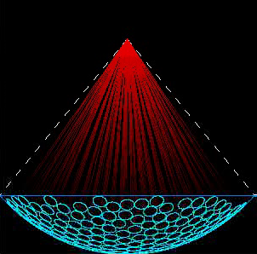
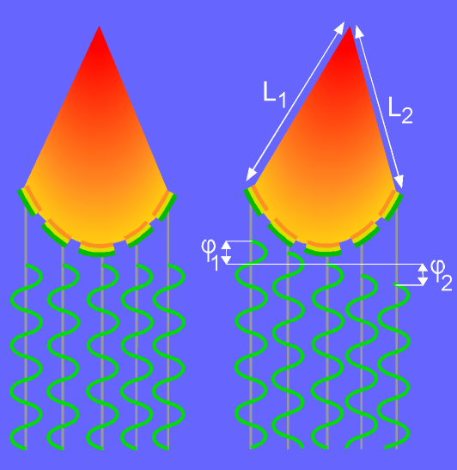
Focused Ultrasound Principles
Ultrasound generates 2 types of waves when interacting with tissue
Longitudinal (fluids, soft tissue and bone), and shear waves (bone only)
Pressure is positive during compression and negative during rarefaction of the wave
As waves traverse a lossy medium, attenuation (absorption, scattering and mode conversion) reduces the energy delivery
Waves are focused geometrically, mechanically, or electronically to aim all the energy emitted from the transducer into a small target
Acoustic intensity (power focused over a small area) determines the amount of thermal energy deposited at the focus

Slide 4
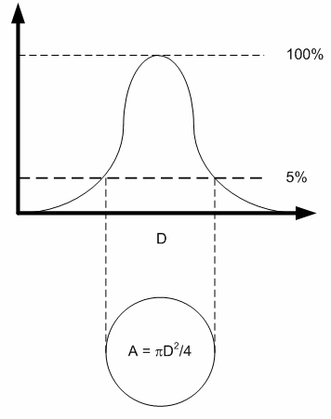
How is Acoustic Energy Described
Electrical Power: delivered to the transducer by the RF amplifier [W]
Acoustic Power: electrical power de-rated by the measured transducer efficiency (η) [W]
Acoustic Intensity (I): Majority of the acoustic power traverses through the FWHM of the focus [W/cm²]
Acoustic Pressure (P): Peak positive (compressional) and peak negative (rarefactional) pressure of the longitudinal ultrasound wave [MPa]

Slide 5
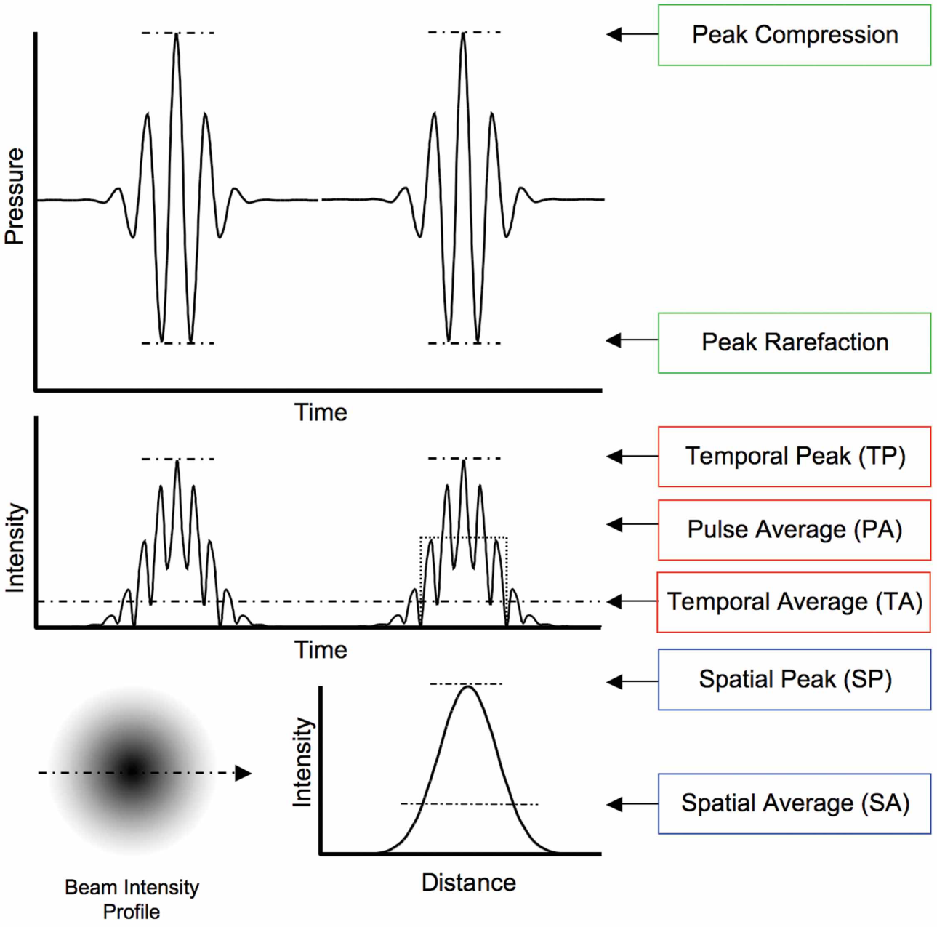
Definitions of Intensity
Pulse Repetition Period (PRP)
I_{SPTP}: related to mechanical bioeffects and cavitation [~MPa²]
I_{SATA}: related to the magnitude of thermal bioeffects [~W/cm²]
I_{SPPA}
I_{SPTA}
I_{SATP}
I_{SAPA}
Pulse Duration (PD)
TR Nelson et al., J Ultrasound Med, 28:139–150, 2009
Notes:
Note: PA and TP are only relevant for PW-mode sonications. CW sonications are intrinsically TA

Slide 6
Attenuation of Ultrasound Waves
As sound traverses tissue, pressure (amplitude) and intensity are derated with distance by the same ratio
Absorption (a): conversion of acoustic energy into heat
Attenuation is frequency dependent and is approximately linear for most soft tissues [dB/cm/MHz]
The goal with thermal FUS therapies is to minimize the attenuation in the near field of the transducer and maximize thermal absorption at the focus

Slide 7
Attenuation of Ultrasound Waves
Attenuation at a depth (d) is modeled as an exponential decay of the wave amplitude (base_{e})
Attenuation is reported using dB (base₁₀)
The Neper [Np] is a base_{e} logarithmic ratio

Slide 8
Therapeutic Ultrasound Interaction with Tissue
Ultrasound
Vibration of Molecules
High amplitude
Threshold Phenomenon
Cavitation
Energy Absorption
2 x 8 mm
Focal spot
Temperature Elevation
Tissue Coagulation
Other effects
Tissue

Slide 9
Ultrasound Treatment Techniques
Cavitation: high-power pulsed-wave (PW) exposures (100-500W, 0.1-10% duty cycle, 1um to 100 ms burst durations) to mechanically break up tissues
Ablation: high-power continuous-wave (CW) exposures (10-200W, 5-60s exposures) to thermally coagulate tissues
Hyperthermia: low-power CW exposures to locally control temperatue without coagulation
Sonoporation: low-power PW exposures (usually combined with a microbubble contrast agent) to mechanically weaken cell membranes, open tight-junctions between cells, etc.

Slide 10
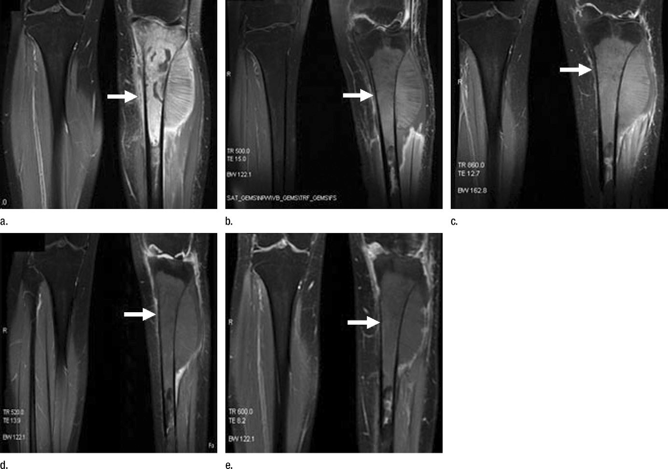
HIFU Treatment of Bone Tumours
Gd-T₁-w MRI of an 18-year-old woman who underwent HIFU ablation for tibia osteosarcoma. (a) Before HIFU treatment shows a hypervascular lesion (arrow) in the tibia. Images obtained (b) 2 weeks and (c) 12, (d) 24, and (e) 36 months after HIFU show no evidence of enhancement in treated tumor region (arrow).
[1] Primary Bone Malignancy: Effective Treatment with High-Intensity Focused Ultrasound Ablation Chen W., et al., Radiol., 2010; 255(3):967-78.

Slide 11
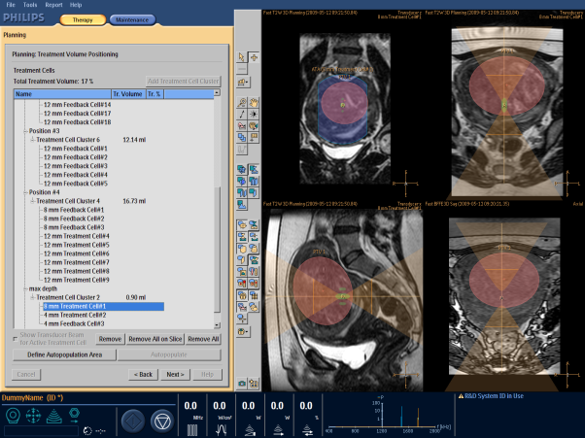
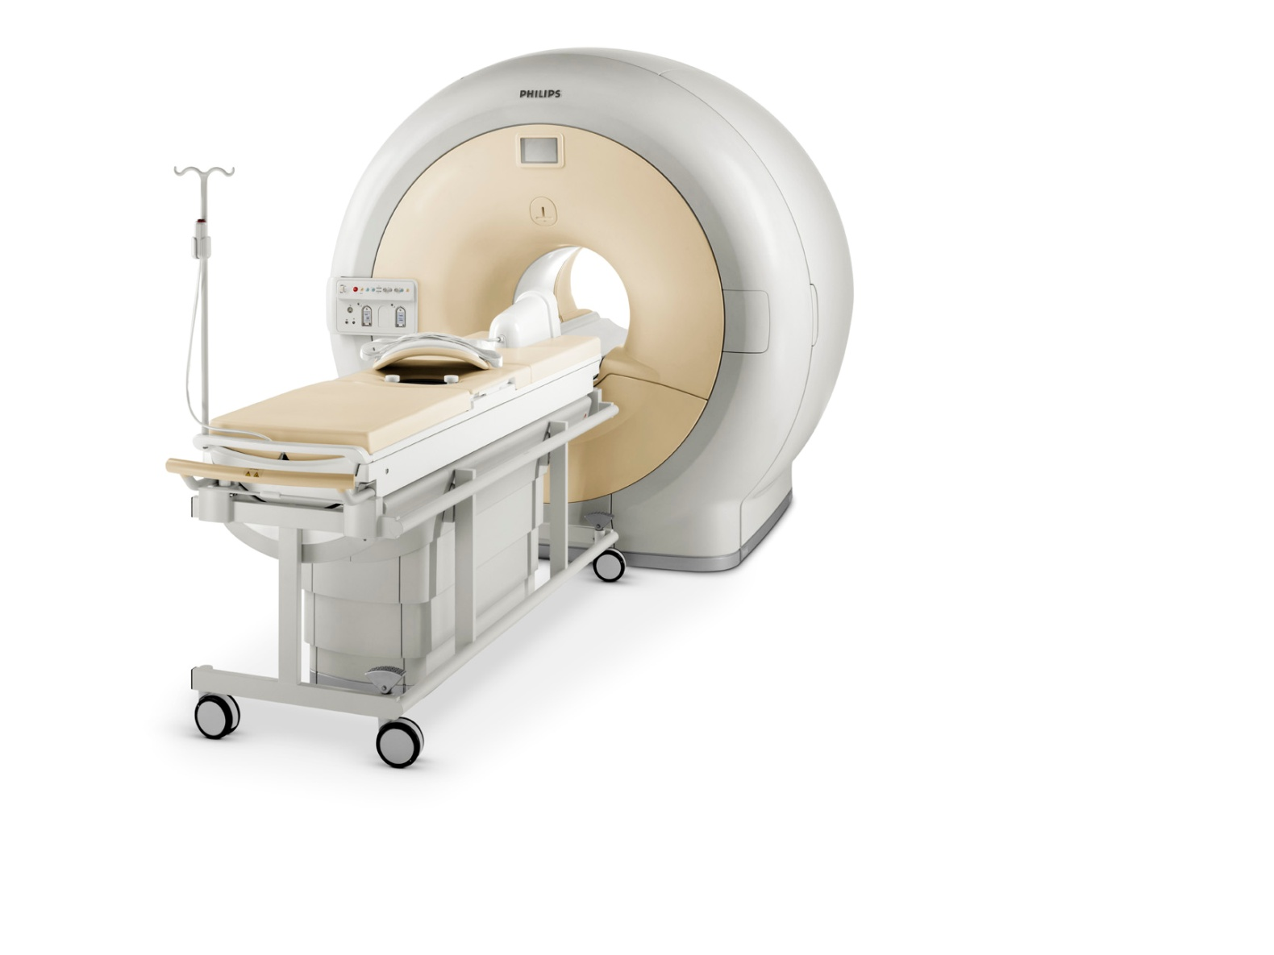
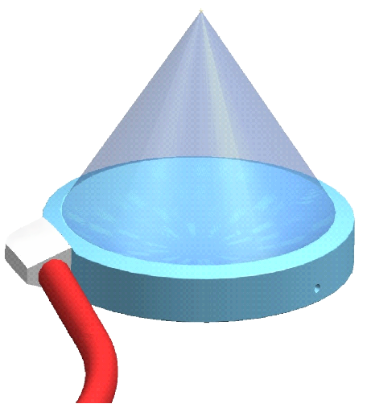
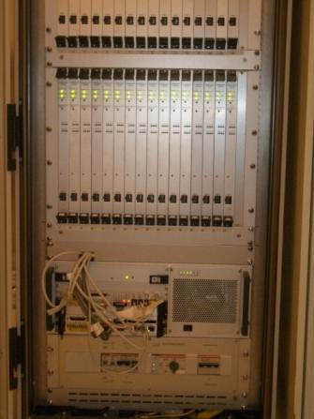
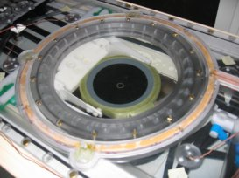
How Does MR-HIFU Work?
Philips 3T MRI with Integrated HIFU
Focus
3D anatomy and
temperature mapping
Transducer
Therapy Console
Transducer Embedded in
Therapy Table
RF
Power
Motor
Control
Thermotherapy
Phased Array Transducer
Ultrasound Driving Electronics

Slide 12
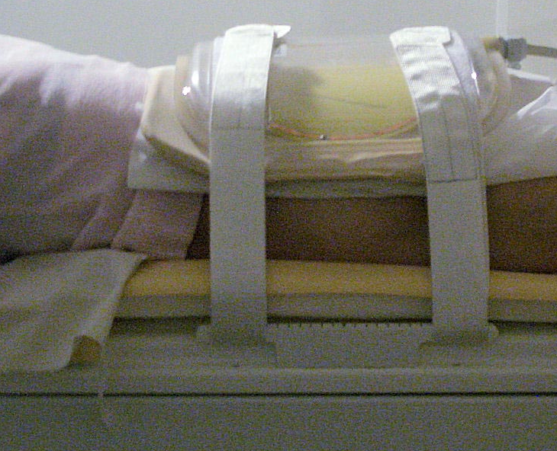
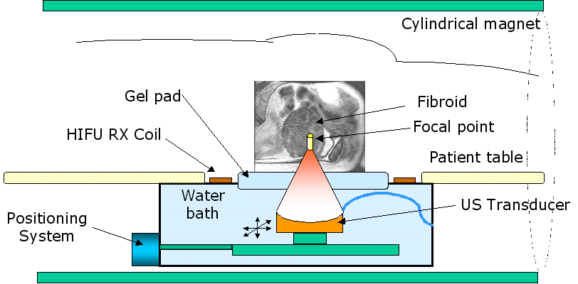
System Setup

Slide 13
MR-HIFU Treatment Facility
Operator’s Room
Magnet Room
PELVIC COIL
ACHIEVA
MAGNET
MR CONSOLE
OPERATOR
HIFU PLANNING
CONSOLE
SAFETY DEVICE
.
FILTER PANEL
GENERATOR
CABINET
Equipment Room

Slide 14
MRI Thermometry
Temperature measurement is based on the water proton resonance frequency (PRF) shift induced phase differences between dynamic frames
Temperature in bone and fat tissue can not be measured with the PRF method
From MR dynamic phase images a relative frequency shift is be calculated
The phase of a MR image is sensitive to disturbances such as transducer movement and magnetic field drift and to patient movement

Slide 15
MR Thermometry
Temperature maps calculated from phase differences between successive dynamic frames as
Temperature maps are calculated on-line during sonication and displayed as overlays on the magnitude image

Slide 16
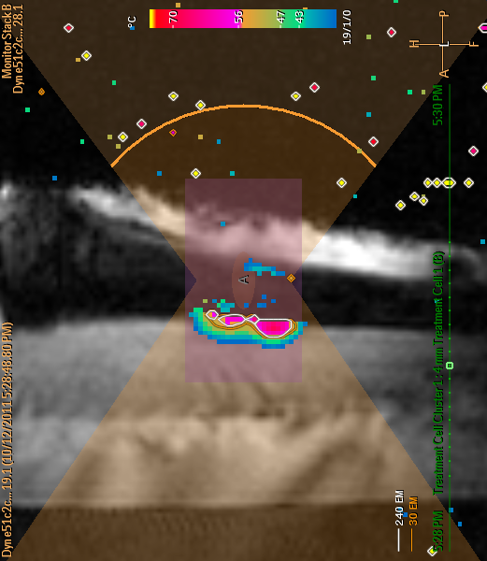
Bone MR Thermometry Example
Heating signal is strong at bone surface but non-existant in the cortical bone and fatty bone marrow.

Slide 17
Thermal Dose Model
Thermal dose is calculated on a voxel-by-voxel basis as a time integral as temperature is measured throughout treatment
240 EM (equivalent minutes) at 43°C is sufficient to cause thermal necrosis in “soft tissue”
Caution: a 1 second exposure at 57°C can produce thermal necrosis (273 EM)

Slide 18
Advantages with this Model
The increase in the rate of cell killing with temperature is relatively constant (for T>43, T<43)
For every degree above 43°C the required time to coagulate the tissue halves (120 minutes @ 44°C, 60 minutes @ 45°C)
Formulation relates all time‐temperature curves back to a single temperature, chosen arbitrarily as 43°C – trend seems to be conserved across multiple cell types, even though sensitivity to heat will differ
Model valid for high temperatures seen in HIFU
Valid for tissues with different thermal sensitivity but threshold for thermal dose required for cell death changes

Slide 19
Problems with this Model
Different tissues have varying thermal sensitivity and will ablate at different thermal doses:
“soft tissue” will become necrotic at 240 EM
Nerve tissue may damage at much lower doses
Bone may require much higher dose for ablation
Non‐linear response between temperature and cell death → higher probability of dying with increasing temperature and time of exposure
Measuring dose does not directly predict damage
Model primarily validated for cell cultures so ambiguity between calculated thermal dose and ablation volumes from imaging/pathology

Slide 20
Pennes Bioheat Transfer Model
Proposed in 1940s for modeling heat transfer in the body due to an externally applied heating/cooling sources
Harry Pennes (a Neurologist at Columbia Univ) experimented on patients by inserting thermocouples into patients’ forearms
Model accounts the thermal conductivity, specific heat capacity, and blood perfusion of specific tissue types (muscle, organs, skin, etc)

Slide 21
Pennes Bioheat Transfer Equation
Validated heating model (does not predict dose or thermal damage) that has “stood the test of time” against other models and is applicable to many different heating source types (ultrasonic, RF, laser, etc.)
Highly dependent on “good” tissue properties

Slide 22
Modeling Questions
Can a tissue type dependant thermal damage model (similar to the Pennes Bioheat model for tissue heating) be derived that takes into account the thermal dose, thermal conductivity, thermal diffusion, specific heat, and perfusion of the tissue of interest and surrounding structures?
Can a spatially dependant (and perhaps a patient specific) thermal damage model be derived which can work directly with intraoperative temperature measurements to better predict the volume of ablated tissue during a MR-HIFU treatment?

Slide 23
Some Tissue Properties
Wide range of tissue properties reported in literature spanning over > 50 years.
Conductivity, specific heat, and perfusion vary greatly over tissue types.
* Adapted from Scott et al, Int. J. Hyperthermia, 2014; 30(4): 228-244.

Slide 24
More Tissue Properties
Temperature sensitivity varies greatly across tissue types and species
Values in literature are mostly determined from in vitro cell cultures and vary greatly and span many decades
In practice: disconnect between temperature measurement and prediction of resulting thermal damage/dose
* Adapted from Dewhirst et al, Int. J. Hyperthermia, 2003; 19(3): 267-294.

Slide 25
Summary of HIFU
MR-HIFU is a flexible energy-based treatment modality
Focusing the ultrasound beam enhances the treatment over a small target area by a factor of ~1000X
Attenuation is the primary contributor to both losses on the way to the target AND is the mechanism for thermal treatment at the target
MR thermometry “closes the loop” to monitor and control treatment temperatures in real time
Caution: thermal dose builds up cumulatively and at an increasing rate with temperature → Current models do not account for differences in tissue types (may under/ over dose thermo-resistive/sensitive tissues)

Slide 26
References
[1] Sapareto S.A. and Dewey W.C., Thermal dose determination in cancer therapy. Int J Radiat Oncol Biol Phys, 10(6): p. 787-800 (1984).
[2] Sassaroli E., Li K.C.P., O’Neill B.E., Modeling focused ultrasound exposure for the optimal control of thermal dose distribution. The ScientificWorld Journal, Article ID 252741, 11 pages, (2012).
[3] Dewey W.C., Arrhenius relationships from molecule and cell to the clinic. Int J Hyperthermia, 10: p.457-83 (1994).
[4] Pennes H.H., Analysis of tissue and arterial blood temperatures in the resting human forearm. J Appl Physiol, 1: p. 93-122 (1948).
[5] Scott S.J., et al, Interstitial ultrasound ablation of vertebral and paraspinal tumours: Parametric and patient-specific simulations. Int J Hyperthermia, 30(4): p. 228-244 (2014).
[6] Dewhirst M.W., et al, Basic principles of thermal dosimetry and thermal thresholds for tissue damage from hyperthermia. Int J Hyperthermia, 19(3): p. 267-294 (2003).
[7] Roemer R.B., Engineering aspects of hyperthermia therapy, Annu Rev Biomed Eng, 1: p. 347-376 (1999).

